Slide 1


ds
#1
json
Introduction
Syntax
Data types
Json vs xml
Json schema
Json parser libraries in java
Java script object notation
GREEN LEARNER

Slide 2
Introduction
Subset of ECMA-262 3rd edition
Lightweight data-interchange format.
Easy For human to read
Easy for machine to parse and generate
Language independent
Name value pair, normally known as object
An ordered list of values
Universal data structure

Slide 3
JSON is not
A document format
Markup language
Binary structure
Functions

Slide 4
Design Principles
Minimal
Textual
Free

Slide 5
It’s useful for
Data interchange
Configuration
Inter server communication
[Directly from – Douglas Crockford] https://www.youtube.com/watch?v=TjVcVWB0oFk

Slide 6
ds
#2
Introduction
Syntax
Data types
Json vs xml
Json schema
Json parser libraries in java
json
Java script object notation

Slide 7
Syntax
Named Value pairs
Ordered list of objects

Slide 8
Data types
Number
String
Boolean
Array
Object

Slide 9
ds
#3
Introduction
Syntax
Data types
Json vs xml
Json schema
Json parser libraries in java
json
Java script object notation
GREEN LEARNER

Slide 10
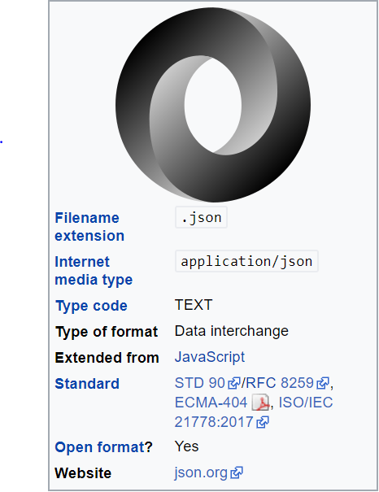
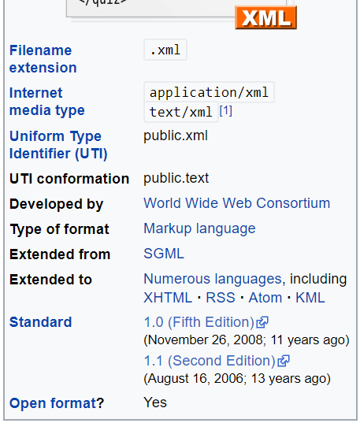
JSON vs XML

Slide 11
JSON vs XML - Similarities
Self describing
Hierarchical
Able to parse
Used as an data interchange format by many programming languages
Can be fetched using HTTP request

Slide 12
JSON vs XML - Differences
XML | JSON
End tags | No end tag
Larger | Shorter
Takes time to read and write | Quicker to read and write
No arrays | Can use arrays
Has to be parse before use | Can be parsed by standard Javascript function
Difficult to parse | Easily parsed

Slide 13
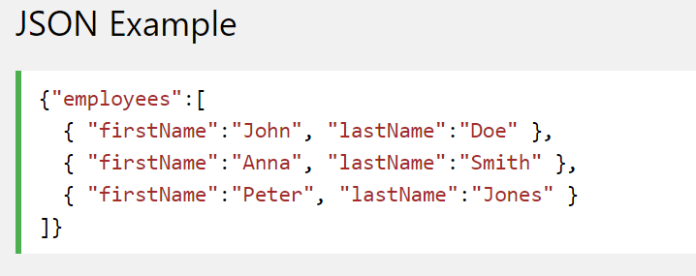
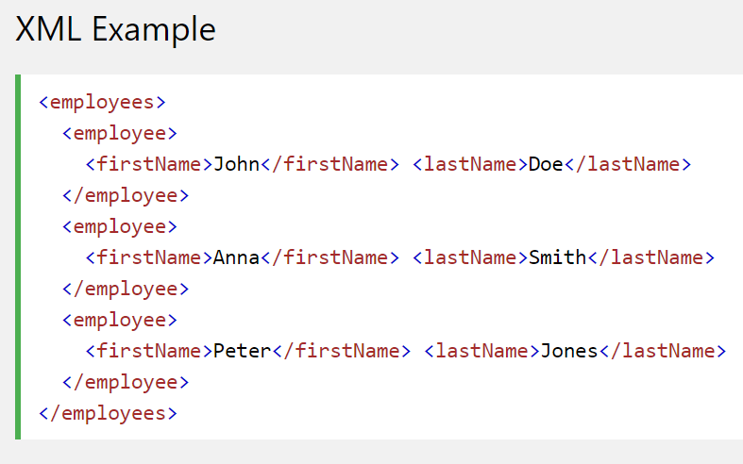
JSON vs XML - representation

Slide 14
ds
#4
Introduction
Syntax
Data types
Json vs xml
Json schema
Json parser libraries in java
json
Java script object notation
GREEN LEARNER

Slide 15
Json Schema
Specification
JSON Schema is maintained at http://json-schema.org.
Defines the structure of Json
Describes existing data format
Clear and human as well as computer readable
Useful for automation testing
Structural validation
Data validation

Slide 16
ds
#5
Introduction
Syntax
Data types
Json vs xml
Json schema
Json parser libraries in java
json
Java script object notation
GREEN LEARNER

Slide 17
Json parser and schema validation in java
Everit
GSON
Jackson

Slide 18
ds
#6
Introduction
Syntax
Data types
Json vs xml
Json schema
Json parser libraries in java – Everit
Jackson
gson
json
Java script object notation
GREEN LEARNER

Slide 19
Json Schema
ds

Slide 20
Json Schema
ds

Slide 21
Json Schema
ds

